Slide 1
Writing UI Applications in PyS60
Feb 1 2007

Slide 2
Example 1
Program an application that does:
Display a text input field on the screen.
The instruction in the text field should say: Type a word :
2. Display a pop-up note stating the result from the previous input field.
(After the user has typed in a word into to the text field and pressed “Ok”).

Slide 3
Example 1
# import the application user interface framework module
import appuifw
# create a text input field:
input = appuifw.query(u"Type a word:", "text")
# create a pop-up note:
appuifw.note(u"The typed word was: " + input, "info")
We import the "appuifw" module to handle UI widgets like text input fields and pop-up notes etc.
Create a single-field dialog (text input field) using the .query() function of the appuifw module.It takes 2 parameters:
label: as label we put the text u"Type a word:" (the u must be there because the phone understands only text declared as unicode, the high commas must be there because label must be given as a string)
type: as type we put "text". It declares the input field as text type (other possible types: "number", "date", "time", "query", "code") . We create a variable called ‘input’, and the result of the text input field into this variable (after user has typed something when he/she runs the script).
Create a pop-up note using the .note() function of the appuifw module. we include in the brackets the 2 parameters: label: as label we put the text u"The typed word was: " + input. This is the text that will appear in the pop-up note.
type: as type we put "info". It declares the pop-up note as info. This puts an exclamation mark in the pop-up note (other possible types: "error","conf")

Slide 4
In Class Exercise
Program an application that does the following:
Display a text input field on the screen.
The instruction in the text field should say: Type your first name:
Display a pop up note stating: Your first name is: <result from input field>
(After the user has typed in a word into to the text field and pressed “Ok”).
Display another text input field on the screen.
The instruction in the text field should say: Type your last name:
Display a pop up stating: Your last name is: <result from input field>
(After the user has typed in a word into to the text field and pressed „ok“).
Display a pop up note stating: Your full name is: <result from both input fields>

Slide 5
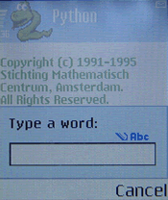
Single-field dialogs
appuifw.query()
# text:
input = appuifw.query(u"Type a word:", "text")

Slide 6
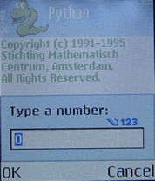
Single-field dialogs
appuifw.query()
# number
input = appuifw.query(u"Type a number:", "number")

Slide 7
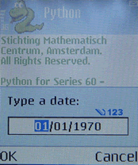
Single-field dialogs
appuifw.query()
# date:
input = appuifw.query(u"Type a date:", "date")

Slide 8
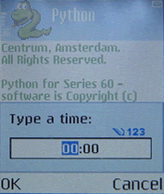
Single-field dialogs
appuifw.query()
# time:
input = appuifw.query(u"Type a time:", "time")

Slide 9
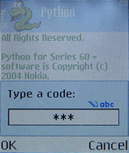
Single-field dialogs
appuifw.query()
# code:
data = appuifw.query(u"Type a code:", "code")

Slide 10
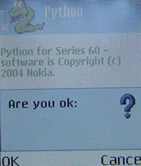
Single-field dialogs
appuifw.query()
# query:
input = appuifw.query(u"Are you ok:", "query")

Slide 11
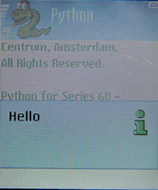
Pop-up notes
appuifw.note()
# info:
appuifw.note(u"Hello", "info")

Slide 12
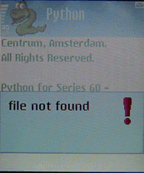
Pop-up notes
appuifw.note()
# error:
appuifw.note(u"file not found", "error")

Slide 13
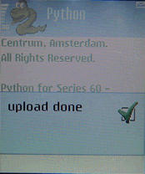
Pop-up notes
appuifw.note()
# conf:
appuifw.note(u"upload done", "conf")

Slide 14
Example 2
Create a pop-up menu with 3 selections:
When executing the script:
After selecting an option from the pop-up menu, a pop up note tells something for each option.

Slide 15
Example 2
When executing the script:
After selecting an option from the pop-up menu,
a pop up note appears for each option.
import appuifw
list = [u“video", u“image", u“text"]
test = appuifw.popup_menu(list, u"Select + press OK:")
if test == 0 :
appuifw.note(u“video, Utube", "info")
if test == 1 :
appuifw.note(u“image, Flickr", "info")
if test == 2 :
appuifw.note(u“text, Google", "info")
Create a pop-up menu with 3 selection options:
The text in option 1 says: video
The text in option 2 says: image
The text in option 3 says: text

Slide 16
In Class Exercise
Write a script that executes a dialog that allows the users to select an item in a list and returns the index (of the list) of the chosen item.
Hint: Use the .selection_list() function of the appuifw module.
Syntax
appuifw.selection_list(choices=list , search_field=0 or 1).
search_field=1 enables a search functionality for looking up items in the list.
IMPORTANT: to activate the find pane (search functionality) you need to press a keyboard key when the script is executed and the list has appeared on the screen.
if search_field=0 no search functionality is enabled.

Slide 17
Example 3: Multi-query Function
import appuifw
# create 2 text input fields at the same time:
appuifw.multi_query(label1, label2)
input1,input2 = appuifw.multi_query(u"Type your first name:",u"Type your last name:")
# print the results on the screen
print input1
print input2

Slide 18
Assignment 2
Due Feb 8, 2007 11:59 pm
Create an interactive script that offers the
Following functionalities: (Total 50 points)
Add entries into the phone’s contacts.
The script needs to ask for first name, last name and mobile number. Then would add to contacts folder.
b) Add entries into the phone’s calendar.
The script needs to ask for name of appointment, location and start time.

Slide 19
Assignment 2
Extra credit (10 points)
Look at the APIs for modules used for
contacts and calendar and try to add more
functionality apart from just adding entries.
(e.g. setting an alarm for an appointment,
deleting entries, etc.)

Slide 20
PyS60 API Reference
http://www.mobilenin.com/pys60/resources/API_Reference_for_Python.pdf
http://www.forum.nokia.com/info/sw.nokia.com/id/a182f1d1-86e7-459f-a69d-689425fb4e7b/PythonForSeries60_2ndEd_SIS1.0.1.zip.html
Just look for “Python for Series 60 Platform API reference” in Forum Nokia

Slide 21
PC Emulator for PyS60
Download and install the S60 C++ SDK from Forum Nokia.
Download the latest PyS60 SDK ZIP package that matches your S60 C++ SDK version from the SourceForge project page. E.g. if you installed the 3rd Ed SDK download, you should get the PythonForS60_SDK_3rdEd.zip.
Unzip the package. It contains another zip package: sdk_files.zip and an uninstaller script.
Unzip sdk_files.zip in the directory that contains the epoc32 directory of your S60 C++ SDK. E.g. for 3rd Edition you would unpack the ZIP in the directory “C:\Symbian\9.2\S60_3rd_FP1".

Slide 22
PC Emulator for PyS60
Load your script into the Emulator (copying your *.py file to a specific local folder in the epoc32 folder of your S60 SDK) for testing on emulator. (Eg: I put the script in C:\Symbian\9.2\S60_3rd_FP1_4\Epoc32\release\winscw\udeb\z\Python).
Open the python application via the "snake" icon on the emulator and run your script.

Slide 23
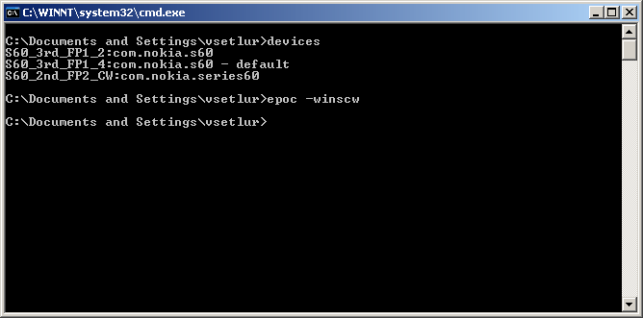
Launch emulator

Slide 24
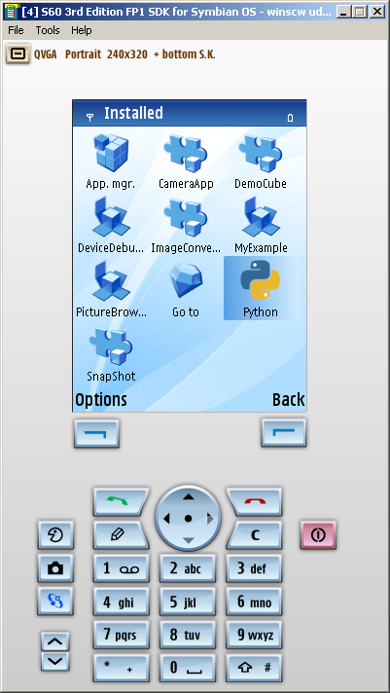
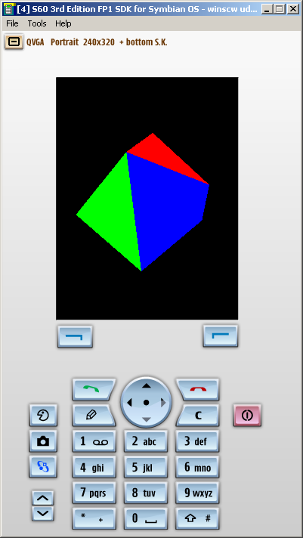

Slide 25
PUTools
Possible currently via Bluetooth.
You need to modify the scripts to work for USB.

